Slide 1





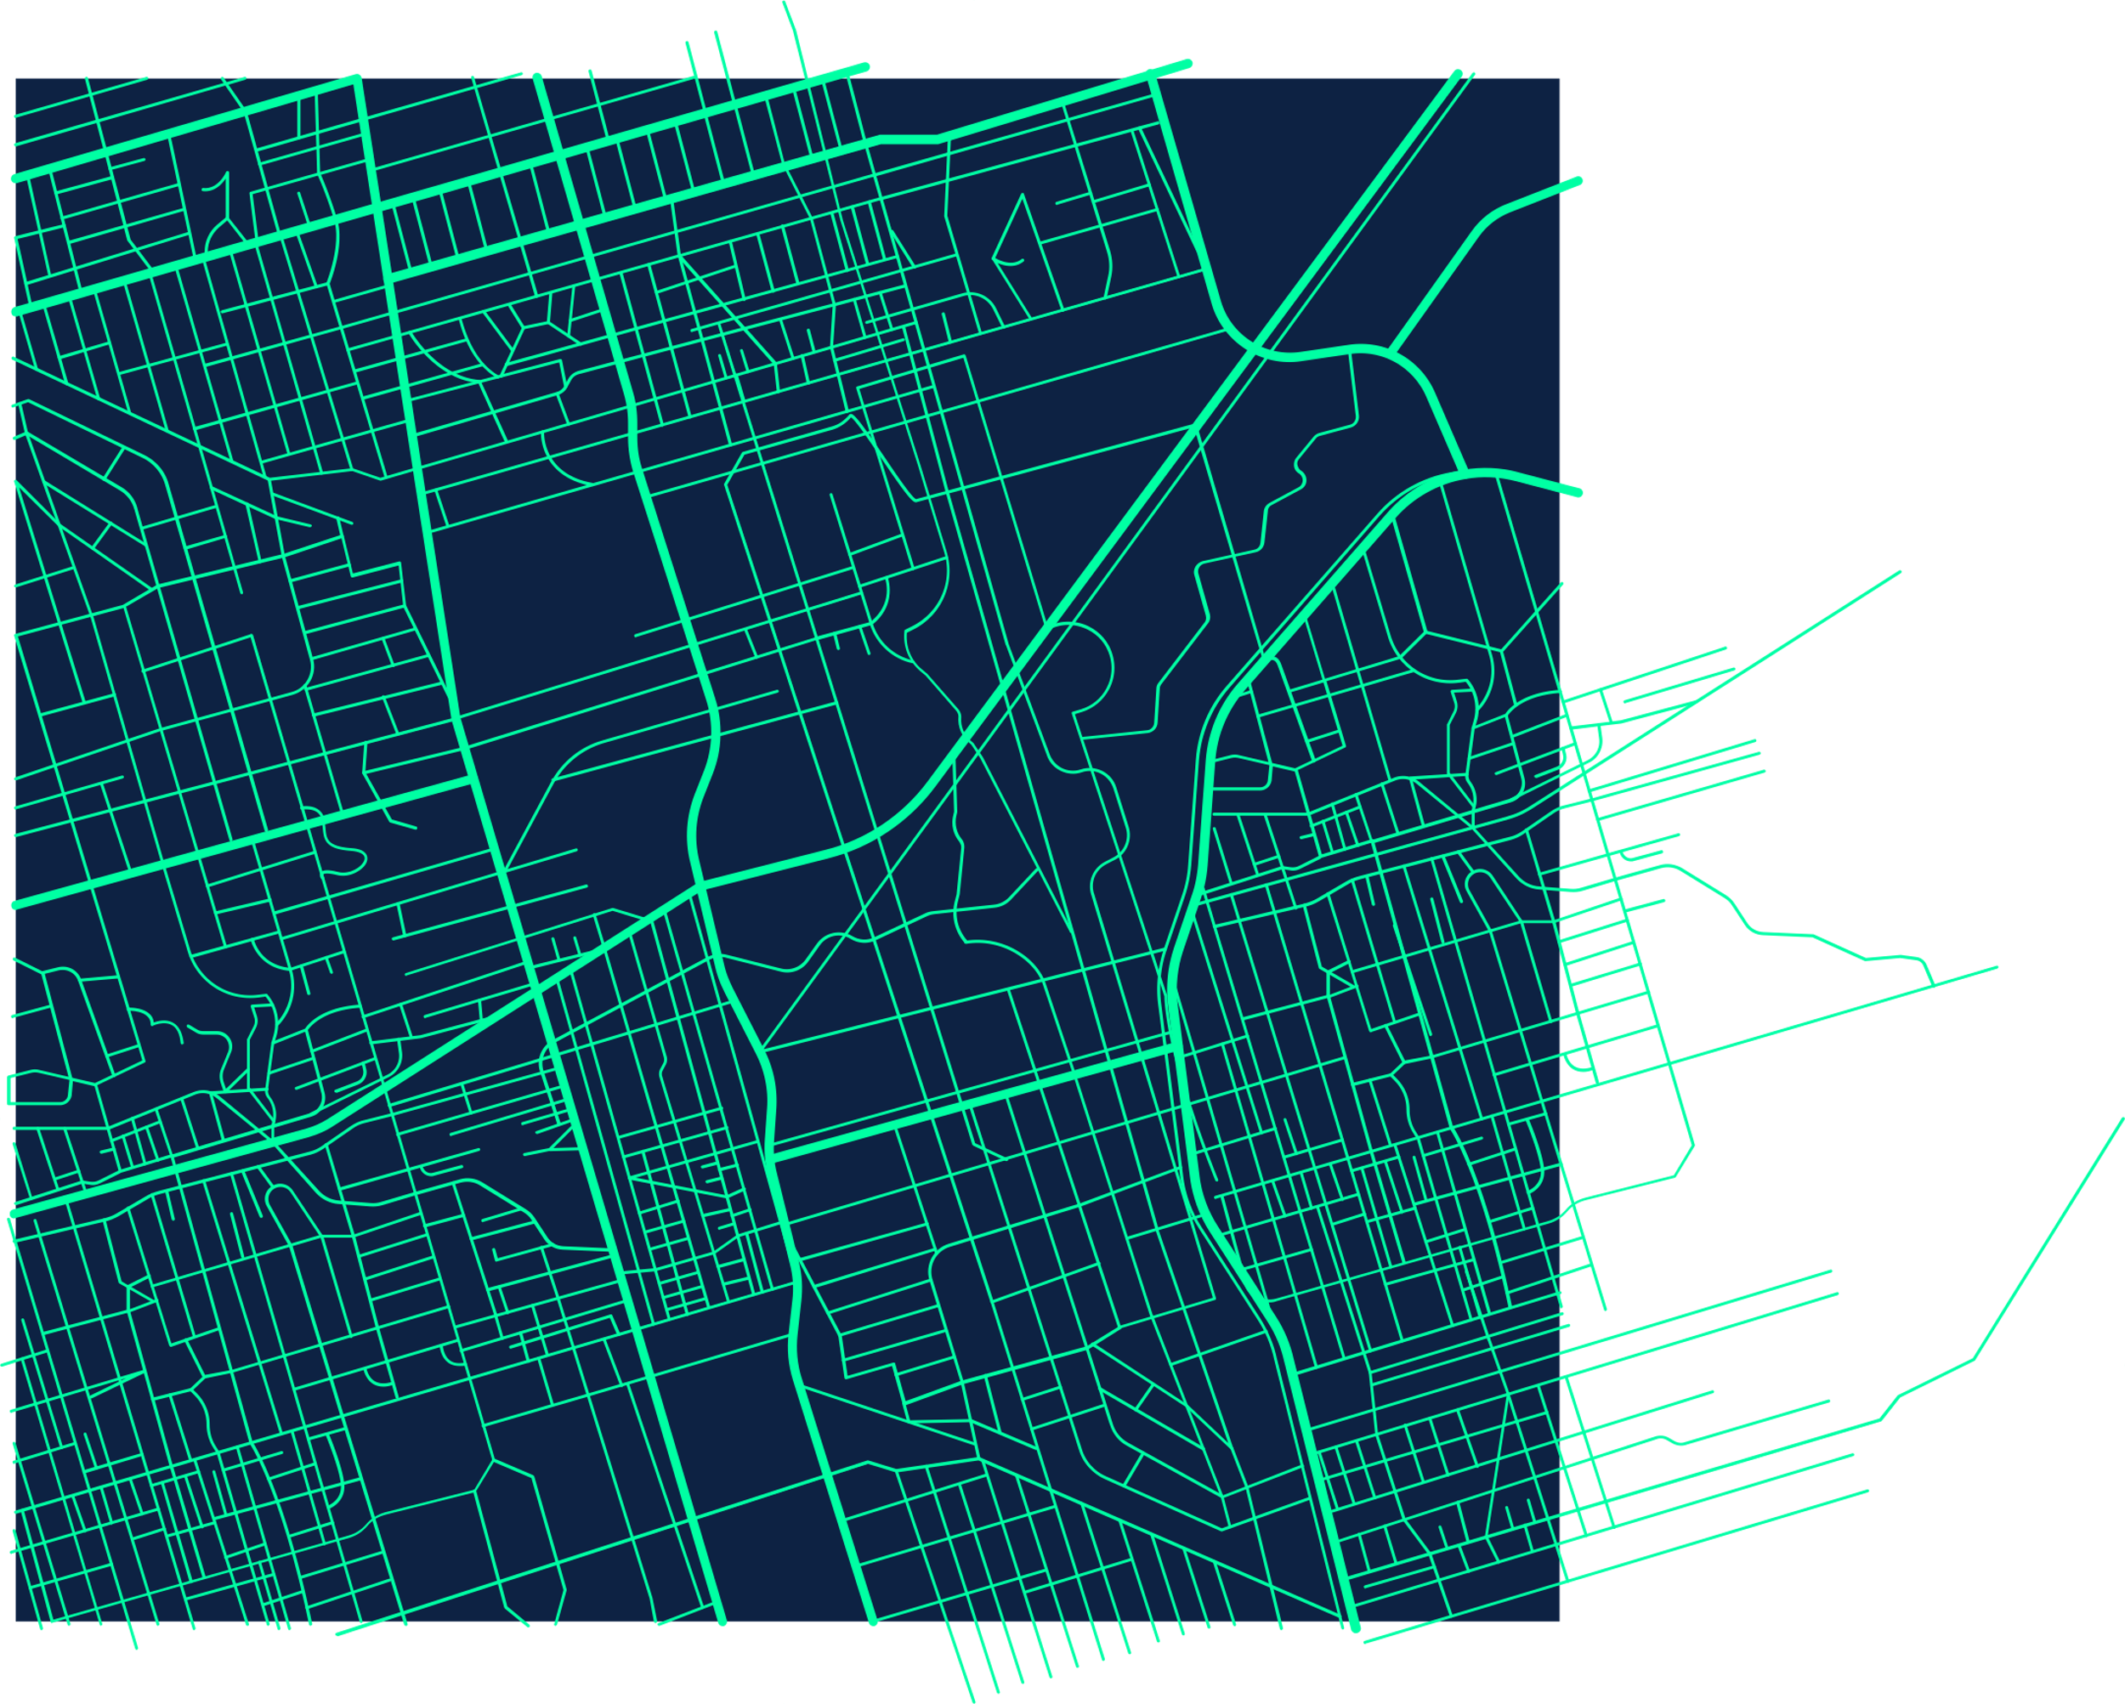
CIS 4560-02
Group 5
Chicago Crime Data Analysis
By: Isabella Jimenez, Jasmine Carvalho, Karla Salazar, Sherman Liang

Slide 2
Introduction
Dataset: Chicago Crimes 2001–Present (City of Chicago Data Portal)
Includes: Reported crimes from 2001–today — date, district, community area, location, and type
Goal: Identify crime trends and patterns across time and location
Focus: Crimes by year, district, time, and type
Tools: Hadoop, Hive, Excel, and Power BI

Slide 3
Data Specifications
Data Set: Crimes_2001_to_Present_2025 | Size: 2.2 GB
Chicago_locations_2001_2012 | Size: 908.4 MB
Chicago_locations_2013_2025 | Size: 592.6 MB
Chicago_summary_by_year_type | Size: 19 KB
Chicago_daily_hourly_trends | Size: 2 KB

Slide 4
Cluster Specifications
OCPU’s | 6
Memory | ~16 GB per node
Storage | 80-100 GB per node
CPU speed | 2.45 GHz
CPU Model Name | AMD EPYC 7763 64-Core Processor

Slide 5
Hadoop Specifications
Hadoop Cluster Version | Hadoop 2.7.1.3.4.2.0-258
Hive version | Hive 1.2.1000.2.4.2.0-258
Number of nodes | 5
HDFS capacity | 390.2 GB total

Slide 6




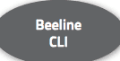





Architecture Chart
Upload
Download
Notes:
Use the Waze presentation & these pictures as examples on how to make the Architecture Chart.

Slide 7
Implementation Flow Chart
Download dataset from City of Chicago Data Portal
2. Upload dataset to HDFS
3. Create external tables in HiveQL
6. Visualize data using Excel and Power BI
5. Export results to CSV
4. Create summary tables for analysis

Slide 8
Implementation of Analysis
Step 1: Downloaded the Chicago Crimes 2001–Present dataset from the City of Chicago Data Portal. Step 2: Uploaded the CSV files to the Hadoop cluster (via HDFS). Step 3: Created external Hive tables (chicago_raw, chicago_cleaned, and chicago_final) to store and manage data. Step 4: Defined HiveQL schemas specifying key fields such as date, district, community area, latitude, longitude, and crime type.

Slide 9
Implementation of Analysis(Cont’d)
Step 5: Cleaned data in Hive by removing null values, standardizing date formats, and selecting important columns. Step 6: Created summary tables to group data by year, district, time, and crime type. Step 7: Exported summary results to CSV for visualization. Step 8: Built visualizations using Excel 3D Maps and Power BI dashboards to show spatial and time-based crime trends.

Slide 10
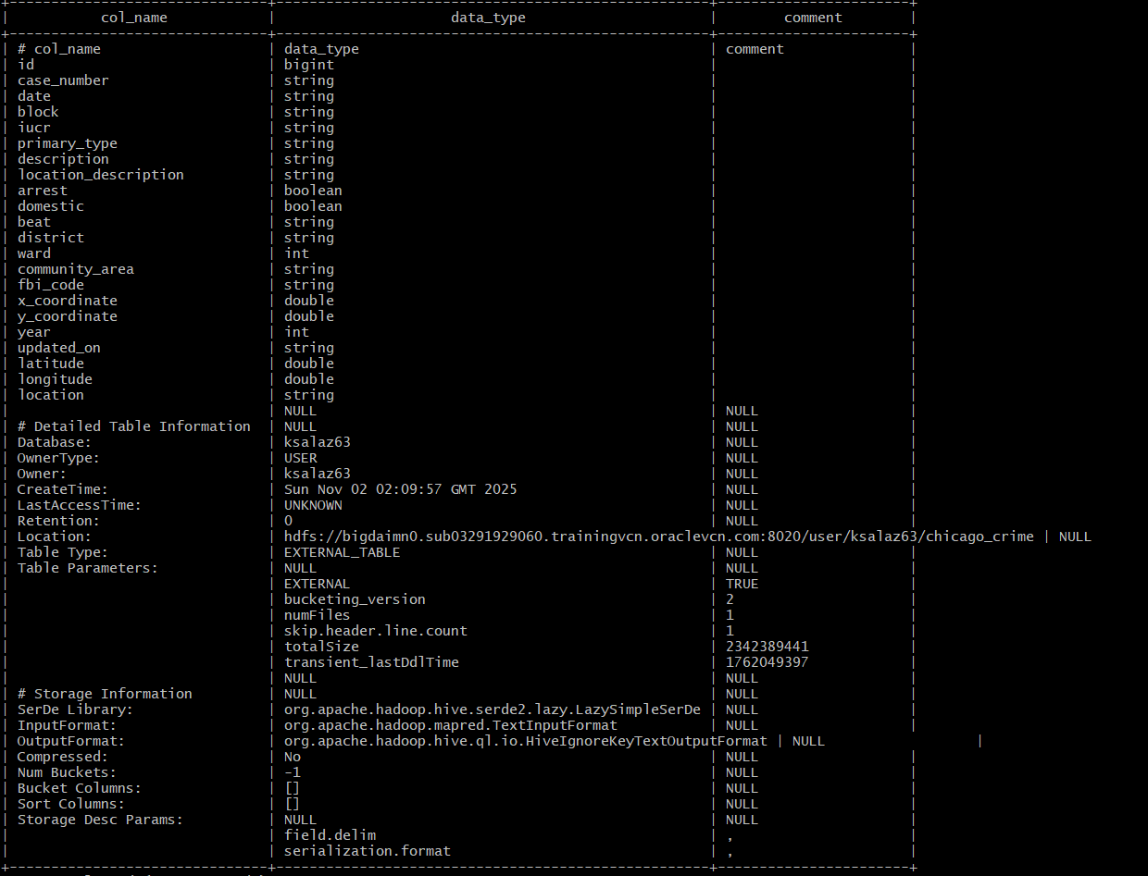
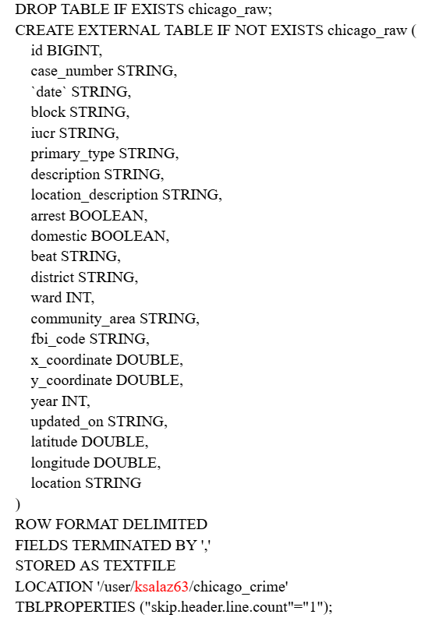
1st External Table:
chicago_raw

Slide 11
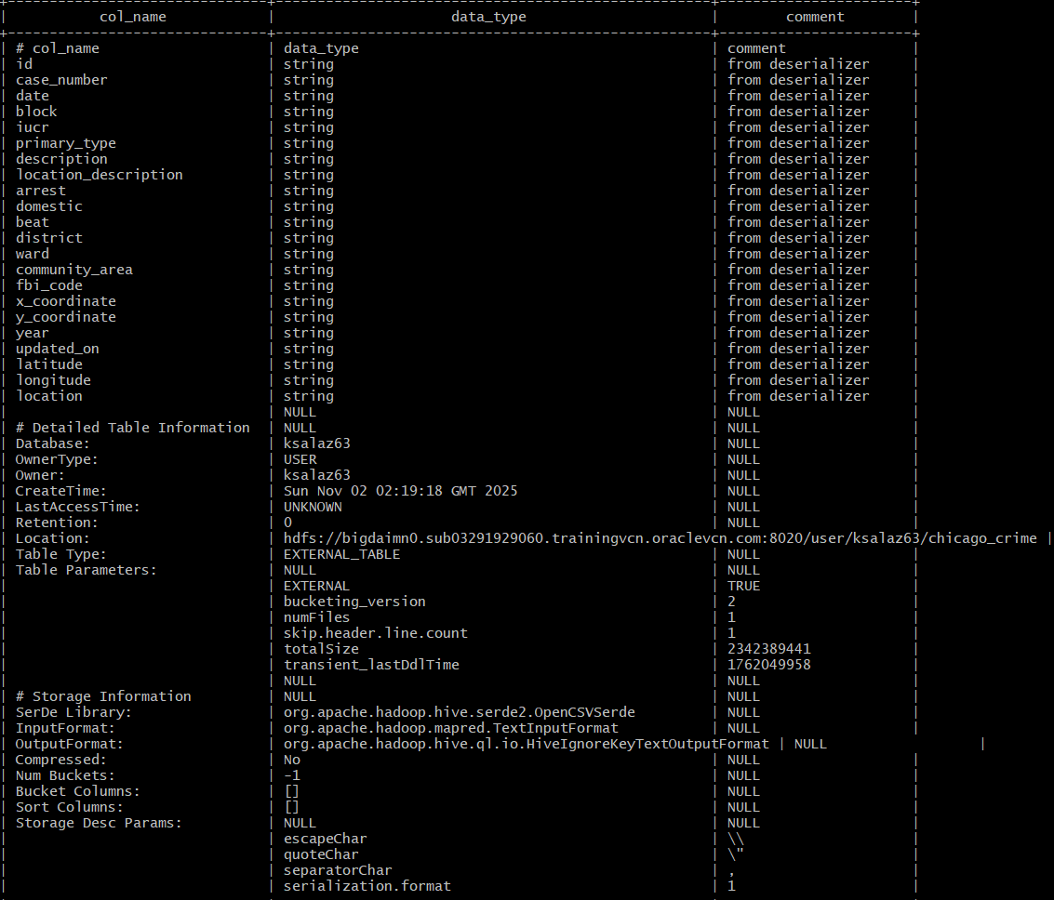
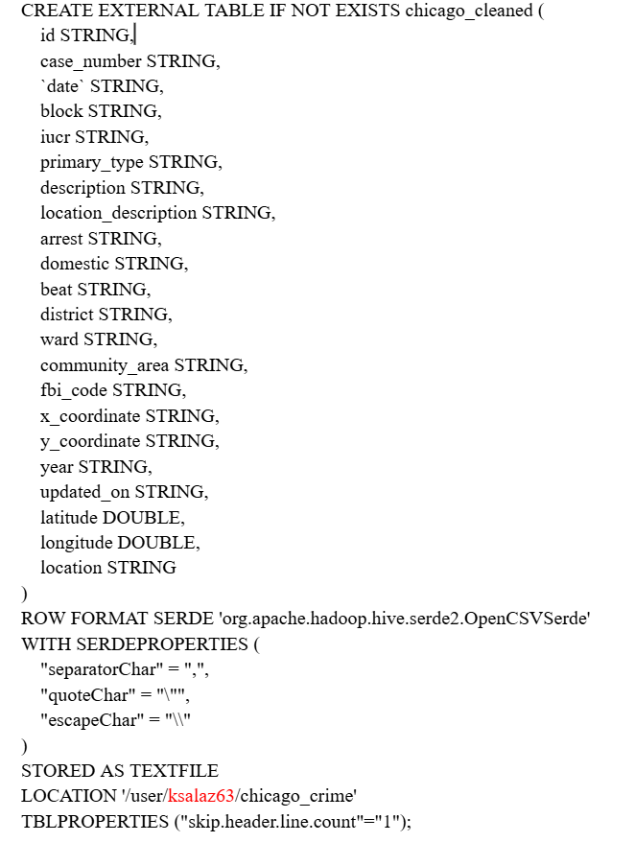
2nd External Table:
chicago_cleaned

Slide 12
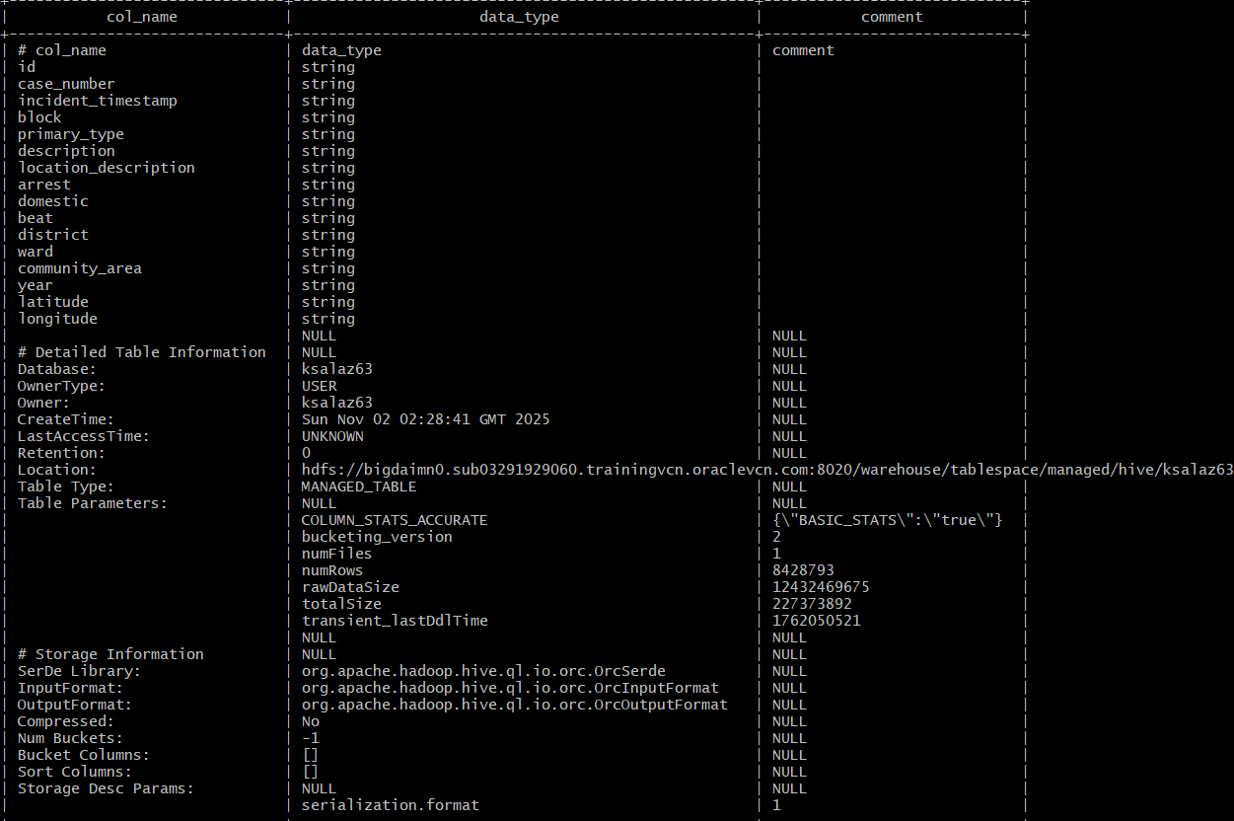
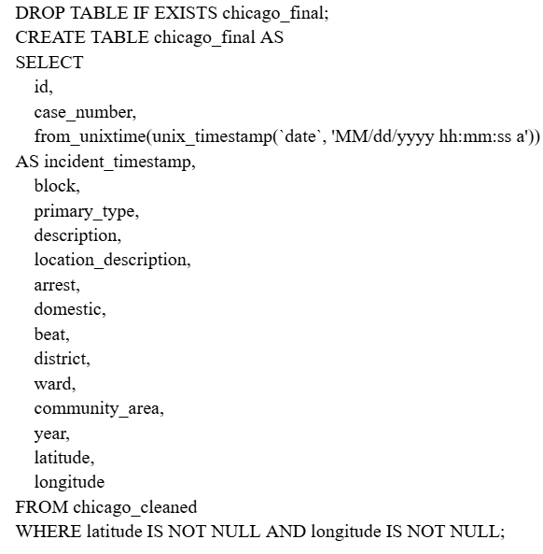
3nd External Table:
chicago_final

Slide 13
Visualization
Information we are using:
Time/Date (Year, Hour, Day of Week)
X and Y coordinates (Longitude & Latitude)
District
Crime type (Sum/Count)
Tools we are using:
Excel - 3D map
Power BI - Bar, Line, and Pie Chart

Slide 14



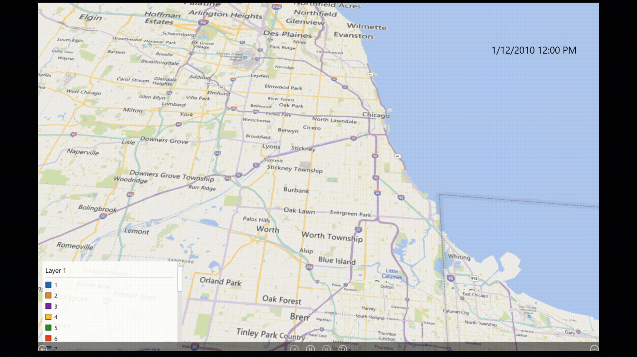
Timeline: Map of Crime Frequency by District (2010-2012)

Slide 15
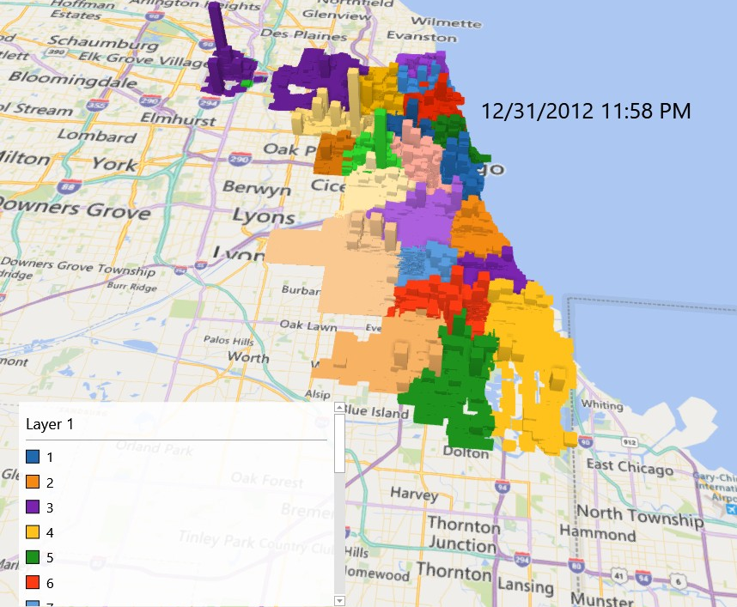
Map of Crime Frequency by District
(2010-2012)
2010-2012
Key Findings
Highest activity — South and West Side districts (7, 8, 9, 10, 11, 15, 25) consistently show the tallest spike,.
Moderate activity — Downtown and Near North (1, 18) maintain steady mid-level bars.
Lowest activity) — North and Northwest districts (16, 17, 19, 20, 24) show smaller and stable bars.

Slide 16
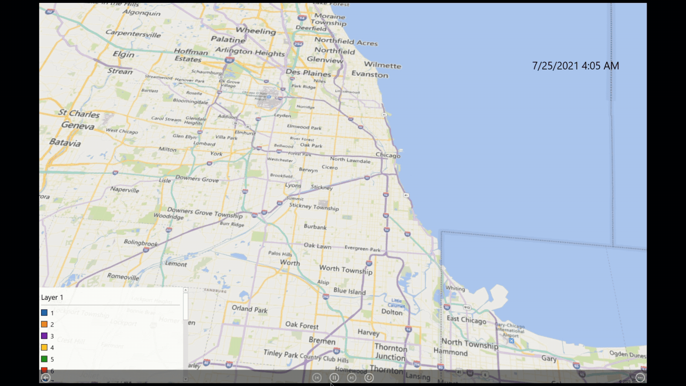
Timeline: Map of Crime Frequency by District (2021-2025)

Slide 17
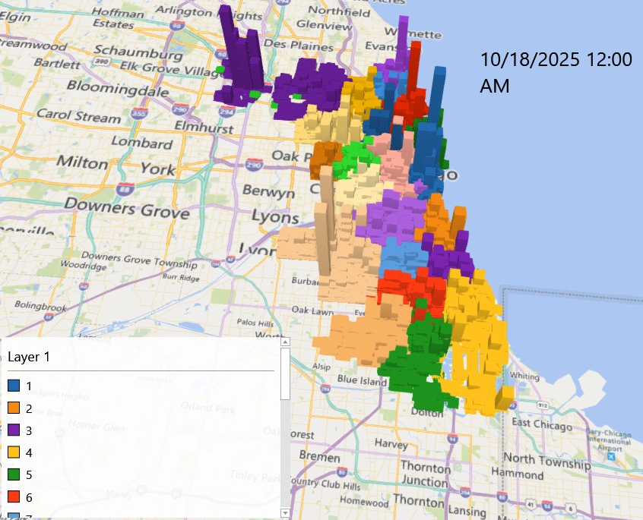
Map of Crime Frequency by District
(2021-2025)
2021-2025
Key Findings
Highest activity— Remains in South and West Side districts (7, 8, 9, 10, 11, 15, 25), with District 11 and 7 showing the largest and most persistent spikes.
Activity increase— In Downtown and Near North districts (1, 12, 18) w/ increasing theft, robbery, and vehicle crime compared to earlier years.
Emerging changes— New moderate hotspots created in several North and Northwest districts (16, 17, 19).

Slide 18
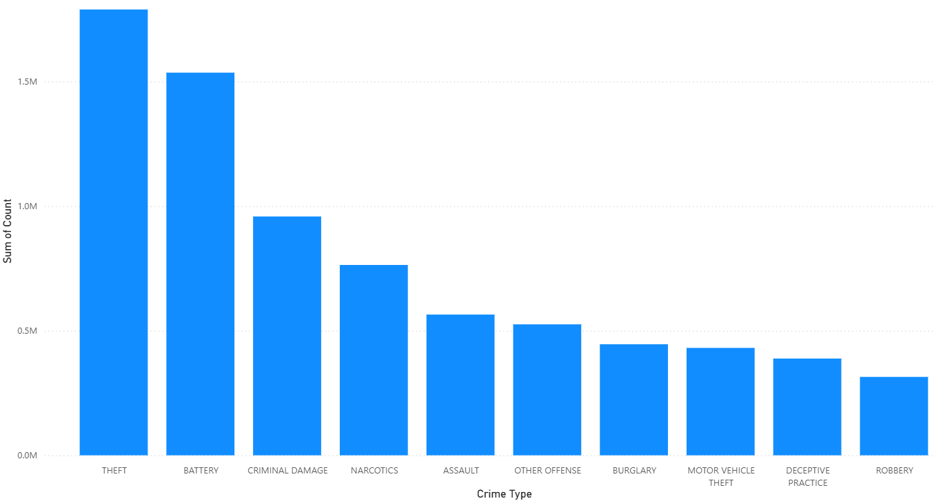
Sum of Count By Crime Type

Slide 19
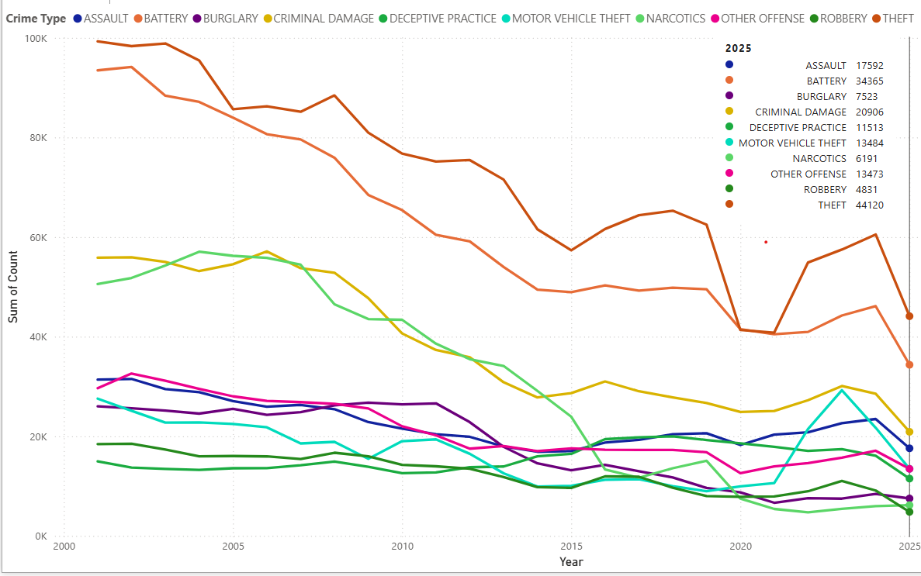
Trends of Top 10 Chicago Crime Types
Key Findings
Overall Trend: Overall crime is trending down.
Top Crimes: Theft, Battery, and Criminal Damage remain most frequent (over 20+ years).
Narcotics: High initially, plummeted since the early 2000s
Downward Trend: Among offenses like Assault, Motor Vehicle Theft, Burglary, and Robbery.
Recent Spike: Despite the downward trend, all top ten crime categories have seen a spike or increase in the 2020s

Slide 20
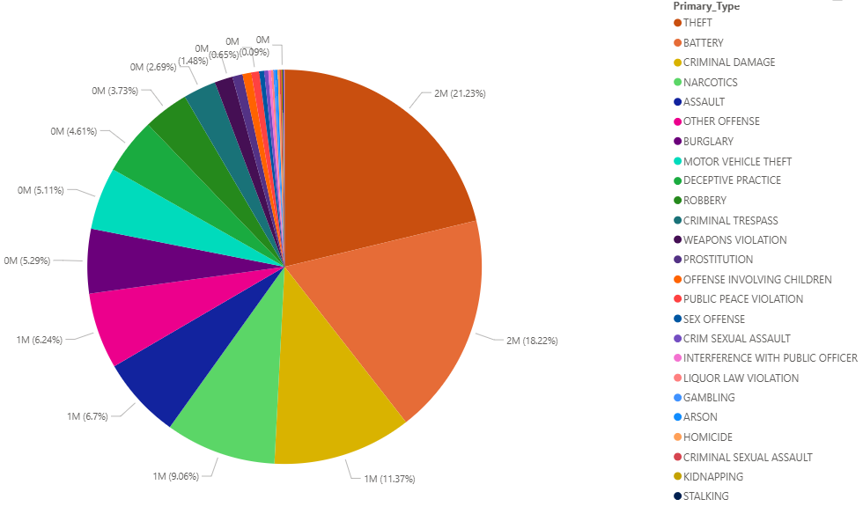
Crime Distribution by Type
Key Findings
Dominant Offense: Is Theft with a percentage of 21.23%.
Top 3 Concentration: Theft (21.23%), Battery (18.22%), and Criminal Damage (11.37%)—together account for ~50% of the total crime volume.
Violent Crime Share: Assault (6.7%) and Robbery (3.73%) represent a smaller share than property/damage crimes
Minority Offenses: Serious felonies (e.g., Homicide, Kidnapping, and Stalking) individually represent less than 1% of the total reported incidents.

Slide 21
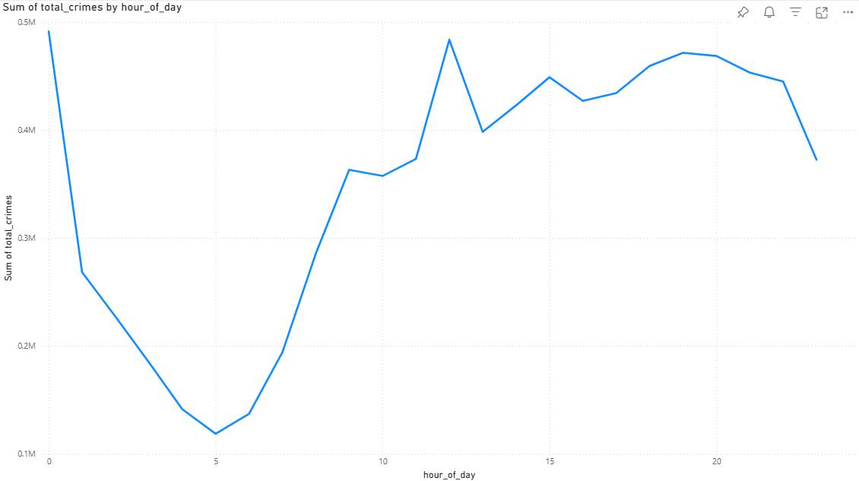
24-Hour Crime Pattern
Key Findings
8 PM
3 PM
Peak Crime Window (The Surge): Occurs in the afternoon and early evening (3 PM- 8PM).
Morning Rush: A lower peak is observed around 9:00 AM, likely coinciding with the start of the typical workday and increased outdoor activity.
Safest Hours (The Trough): In the early morning, specifically between 4:00 AM and 5:00 AM.
Sustained Daytime Risk: Crime levels remain relatively high and steady throughout the entire workday.
9 AM
4 AM
5 AM

Slide 22
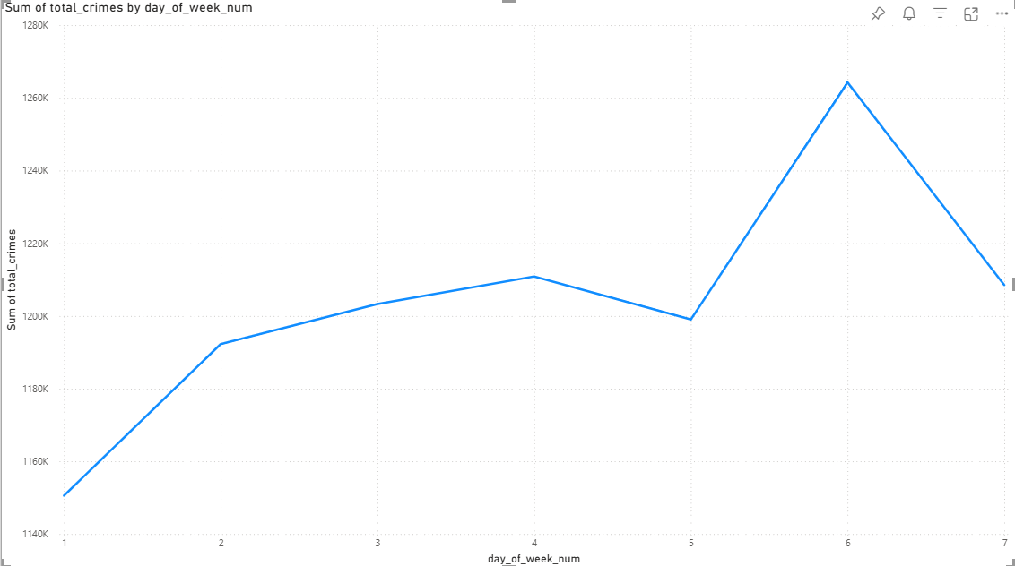
Total Crime Count by Day of Week
Key Findings
Peak Day: Friday (D6) experiences the highest volume of crime throughout the week
Lowest Day: Sunday shows the lowest overall crime count (lowest point)
The Weekend Effect: Crime volume peaks on Friday and sees a notable drop on Saturday.
Mid-Week Consistency: Crime levels are high and stable across the main weekdays (Mon–Thurs)
Sun.
Mon.
Tues.
Wed.
Thurs.
Fri.
Sat.

Slide 23
Conclusion
Property Crimes Dominate: Non-violent offenses, primarily Theft, Battery, and Criminal Damage, account for nearly 50% of all reported incidents in the dataset.
Predictable High-Risk Times: Crime is highly time-dependent, peaking during periods of high public activity.
The highest risk occurs on Fridays and during the afternoon/early evening hours.
The lowest crime activity is reliably recorded on Sunday and in the predawn hours (4:00 AM–5:00 AM).
Spatial Focus & Recent Surge: Risk remains concentrated in South and West Side districts. Despite historical declines, all major crime categories have experienced a concerning spike since the 2020s, demanding new attention.

Slide 24

GitHub Link
https://github.com/ksalaz63/ChicagoCrime2001-2025
Tutorial
Presentation
Codes
Report

Slide 25


